Slide 1

Social Interaction and Social Structure
Ms. Kauser Malik
Lecturer (Sciences & Humanities)

Slide 2
Learning Outcomes
Introduction to Social Interaction
Five types of Social Interactions
Social Structure and its elements
Society and types of societies

Slide 3

Social Interaction
Refers to the dynamic exchanges between individuals or groups, encompassing a wide range of behaviors, from brief exchanges to prolonged engagements.
It is a fundamental process through which people share information, create relationships, and define social structure and roles.
Involves some form of the communication of information or the expression of some culturally accepted idea between two or more individuals or groups through symbols, language, or gestures. Occurs every single day.
Verbal Interactions
Non-verbal Interactions
Two main methods of communication used in social interactions:

Slide 4
Types of Social Interactions
According to Nisbet, an American sociologist, there are five key types of social interaction:
Exchange
Cooperation
Competition
Conformity
Coercion

Slide 5

1. Exchange
The most basic type of interaction.
An individual or a group acts in a certain way toward another individual or group to receive a reward.
The most common type of exchange - between an employer and an employee. The employee has to behave according to the wishes of the employer if they want to receive a reward.
The reward doesn’t need to be monetary or even material. This reward could be as simple as an expression of love, gratitude, or recognition (Nisbet, 1970, p. 56).
Notes:
https://helpfulprofessor.com/social-interaction-types-and-examples/

Slide 6
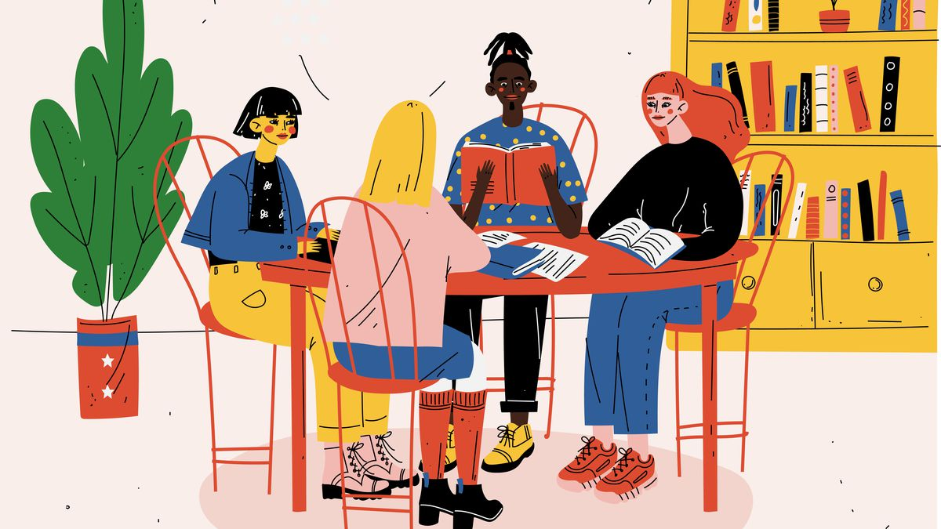
2. Cooperation
Individuals or groups act together to promote common interests or achieve common goals.
EXAMPLE: Students in the group project working together to achieve desired goal rather than competing with each other.

Slide 7
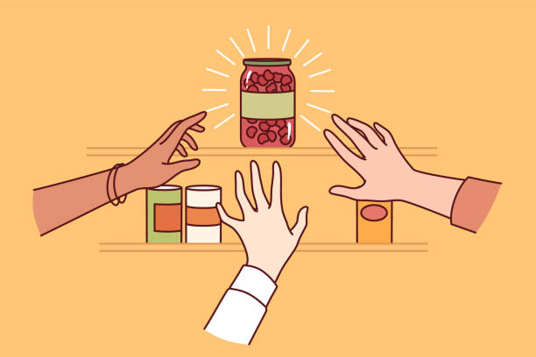
3. Competition
A rivalry where two or more parties strive for a common goal which cannot be shared - where one's gain is the other's loss.
People can compete over tangible resources like land, food, and mates, but also over intangible resources, such as social capital.
Competition is the opposite of cooperation and arises whenever two parties strive for a goal that cannot be shared.
Competition can have both beneficial and detrimental effects. Positively, competition, if it follows rules of conduct may serve as a form of recreation or it helps to motivate people to perform the roles society asks of them. On the negative side, competition can cause injury, psychological stress, inequality, lack of cooperation and even conflict.

Slide 8
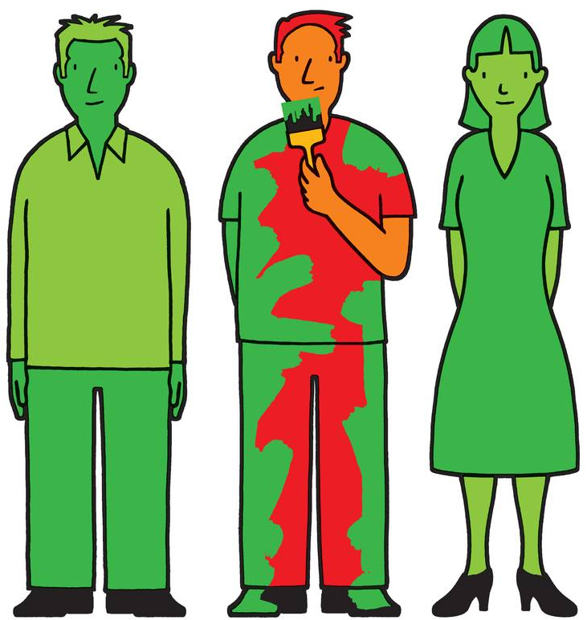
4. Conformity
All behavior that is in accord with the social norms and values of a given social group.
The most common example - In politics, it is common to see an individual stop believing in something only because the political party they are affiliated with does not approve of that belief.
A similar process takes place in friend groups, romantic relationships, family relationships, and so on.

Slide 9

5. Coercion
Compelling an individual or group—either intellectually, morally, or physically to do something; using force or threatening to use force.
Boycott is the withholding of social or economic interaction with others to express disapproval and to force acceptance of demands.

Slide 10
Social Structure

Slide 11
Social Structure
A framework consisting of social institutions (politics, educational and religion), social practices (roles and statuses) and social groups (primary and secondary).
It establishes a society and applies limits on behavior.
Refers to the way in which a society is organized.
A collection of people and relations in a specific geographical areas.

Slide 12
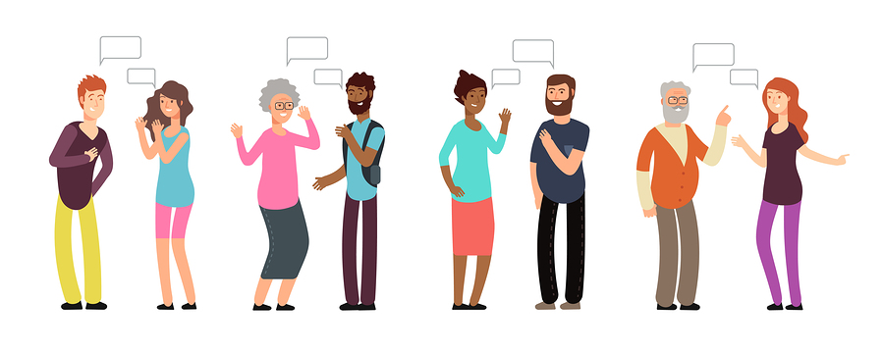
It guides human interaction. Social structure helps people know what is expected of them in most social situations and what they can expect from others.
It is the very foundation in which human beings organize themselves into both simple and complex groups.
The goal is to provide common understanding, community, purpose and security for all of their members.
Allow people the opportunity to be closer to one another and share their mutual thoughts, experiences, and perspectives in order to gain a more complete grasp of the world around them.
These groups include but are not limited to: families, schools, religious organizations, social clubs, etc.

Slide 13
Social structure guides people’s behaviors. The major components of social structure include:
Culture
Social Class
Social Status
Roles
Groups
Social Institutions
A person’s location in the social structure (his or her social class, social status, the roles he or she plays, and the culture, groups, and social institutions to which he or she belongs) underlies his or her perceptions, attitudes, and behaviors.

Slide 14
Social Structure
Social Structure
Statuses
Roles
Expectation
Ascribed
Achieved
Performance
Social Structure
Refers to the way a society is organized.
Status
Role
Is a position in the social structure.
How we (generally) expect members of a status to behave.

Slide 15
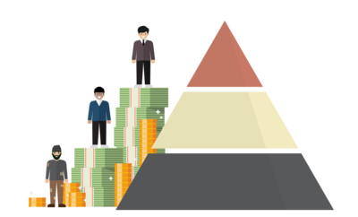
Social Class
Refers to a group of people who have a similar socio-economic status, typically determined by factors such as wealth, education, and occupation.
Depends on
Education level
Cultural beliefs and attitudes
Income level
Social Connections

Slide 16
Status
A status is a socially defined position/rank in society characterized by certain expectations, rights and duties.
Refers to the level of prestige, privilege, and honor someone is perceived to have in society.
A status set is all of the statuses that a person occupies at any particular time.
Each individual in society occupies several statuses. An individual can be a father, a teacher, a husband, brother an African American all at the same time.
Statuses are ways of defining where individuals fit in society and how they relate to others in society.

Slide 17
Types of status
Ascribed Status
Examples: ethnicity, birth order, height, and eye color.
Given to individual generally at birth and from which they cannot escape; these statuses are fixed.
Achieved Status
Example: husband, mother, lawyer, doctor, professor, or student
Positions that are achieved by individuals for themselves ; these status can change.
Master Status
Example: Age, religion, sexual orientation, race, ethnicity, occupation, and socioeconomic status.
The most important status that a person occupies. The dominant one or a status which they view as the most important part of their identity. It often determines people’s perceptions of you and your choices in life.

Slide 18


Roles of Social Structure
Roles are sets of norms that specify the rights and obligations of each status or the behaviors, obligations, and privileges attached to a status.
Status Leader
Roles Organize, set rules, exercise authority.
Every organized community has leader. A leader occupies an important social role. Leaders are necessary to help ensure there is a clear social hierarchy and chain of decision-making.
Example: I have the status of ‘Teacher’; My role is to teach.
Roles are sets of social behaviors assigned to people based upon social status.

Slide 19
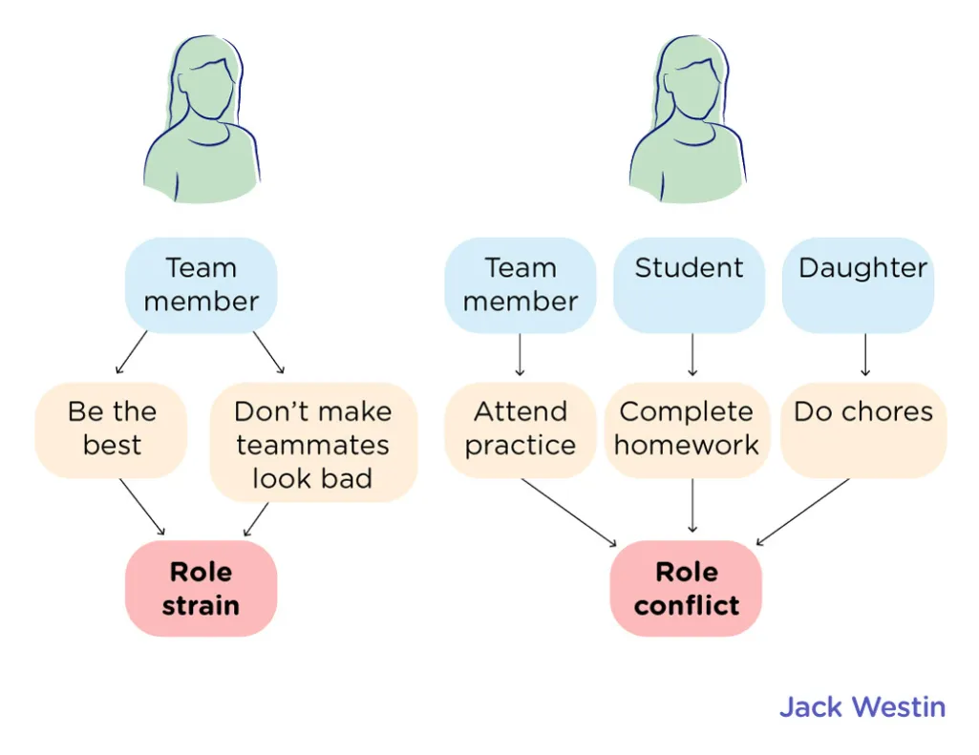
Problems of Social Structure
Role Conflict
A role conflict is when a person is expected to fulfill the duties of two contradictory positions. They face tension in different roles of different statuses.
Example: A person is both dad and a coach. As a father, he wants to see his son participating in the baseball game no matter how good or bad his skills are. As a coach, he has to do what's best for the team. This means he must put in players that are talented and will help the team win the game.

Slide 20
2. Role Strain
Occurs when incompatible role demands develop within a single status. Role strain occurs when a person has difficulty meeting the responsibilities of a particular role in his or her life.
Example: Submission of thesis and exams simultaneously. Or mother (preparation of breakfast, has to iron uniform)

Slide 21
Social Institutions
A place where group of people who come together for common purpose.
The organized, usual, or standard ways by which society meets its basic needs.
Social institution operates, maintains and regulates the society.
It is necessary for the survival of society and has its rules and roles (Example: education system/ school institution)
Exists in every society.

Slide 22
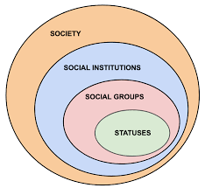
The family, religion, law, politics, economics, education, science, medicine, and the military all are social institutions.
In industrialized societies, social institutions tend to be more formal and in nonliterate societies, more informal.
Each institution has its own groups, status, values, and norms.

Slide 23
5 Major Social Institutions
Family
Religion
Education
Politics/
Government
Economy

Slide 24
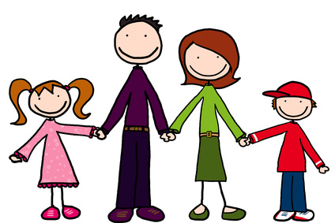
1. Family
Primary and universal social institution
The institution of family is a basic unit in the society, and the multifaceted functions performed by it makes it a much-needed institution in a society.
It is considered a "building block" of society because it is the primary unit through which socialization occurs.
Basic Unit: Marriage
To provide for the rearing of children.
To provide a sense of identity or belonging among its members.
To transmit culture between generations.

Slide 25

2. Education
It is the social institution through which society provides its members with knowledge, including basic facts, job skills, and cultural norms and values.
Responsible for the systematic transmission of knowledge, skills and cultural values within a formally organized structure.
Examples of educational institutes include elementary schools, junior schools, open universities, and vocational training institutes.

Slide 26

3. Economy
Production, distribution and consumption of good and services.
It regulates the economic needs of society.
It is also responsible for the exchange of money and other resources.

Slide 27
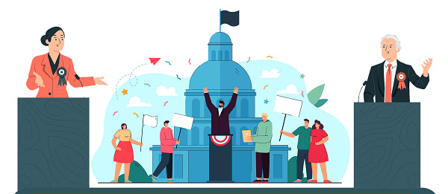
4. Politics/Government
Policy makers
Implement Laws
Responsible for maintaining order, protecting citizens from harm, and providing for the common good.
The government does this through its various sub-institutions and agencies, such as the police, the military, and the courts.
These legal institutions regulate society and prevent crime by enforcing law and policy.

Slide 28

5. Religion
It is an organized system of beliefs and practices designed to fill the human need for meaning and purpose. (Durkheim, 1915).
Satisfies the spiritual needs of humans.
It promotes social solidarity, social cohesion and social control.
Religion can be used to instill moral values and socialize individuals into a community. Religion plays a significant role in shaping the way people view themselves and the world around them.
It can provide comfort and security to those in need. Large religions may also provide a basis for community support, establishing institutions of its own such as hospitals and schools.

Slide 29

Social group
Any number of individuals that share common values, goals and interact on a regular basis.
People who interact with one another and who believe that what they have in common is significant.
Our families
Our different friendship groups
The sociology class and other courses we attend
Our workplaces, the clubs and organizations to which we belong

Slide 30
Types of Social Groups
Primary Group
Secondary Group
Small group of people.
Characterized by intimate, face to face, and emotional relationships.
For example: family and peer group.
Relatively large in size.
Marked by formal, and impersonal relationships.
For example: Club, Residents Welfare Association

Slide 31
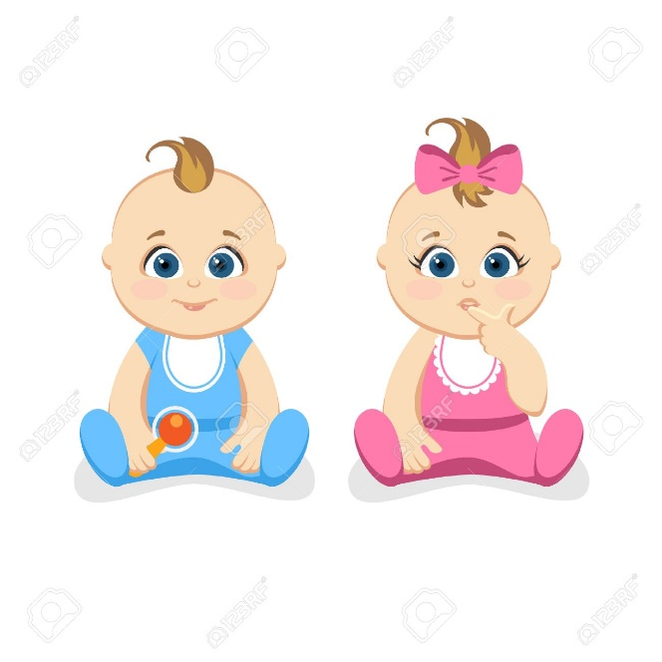
The Social Construction of Reality (Thomas Luckman and Peter L. Berger)
Sociologists generally accept that reality is different for each individual. The term social construction of reality refers to the theory that the way we present ourselves to other people is shaped partly by our interactions with others, as well as by our life experiences.
A school exists as a school not only because it has a building and classrooms with tables, but because everyone associated with it agrees that it is a school. In most cases, your school is older than you, meaning it was created as a school by people before you. You accept it as a school because you have learned that others perceived it as such.
Pink is for girls, blue is for boys

Slide 32
Dramaturgy
A sociological concept developed by Erving Goffman that uses the metaphor of theater to explain human behavior. According to Goffman, a person in life is like an actor on stage. He called this theory dramaturgy.
Dramaturgy refers to the idea that people present themselves to others differently based on their situation and what they want others to think about them.
For example, a person behaves differently when they are at home with friends versus when they are in the office with coworkers. They present a different self and assume a different role, says Goffman. They do not necessarily do this consciously; most of the performance of the self, described by Goffman, happens unconsciously and automatically.
Impression Management – A person influencing another person’s interpretation of a person, place or thing by controlling the information they receive.
The sum total of actions we take — both consciously and unconsciously — to influence how others perceive us.
Notes:
https://www.thoughtco.com/goffmans-front-stage-and-back-stage-behavior-4087971#:~:text=The%20routines%20of%20people's%20daily,category%20of%20front%20stage%20behavior.

Slide 33
Front Stage Self
Encompasses the behavior a player (person) performs in front of an audience (usually society, or some subset of society). A person performs her front stage self when she knows she is being watched and that her behaviors is subject to judgment by an audience.
Back stage Self
In contrast, we may only let our guard down and fully relax when we're by ourselves or familiar people — here we're back stage.
Front Stage Self
&
Back Stage Self

Slide 34



Slide 35
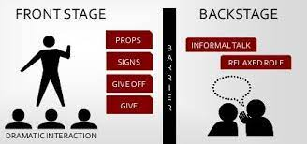
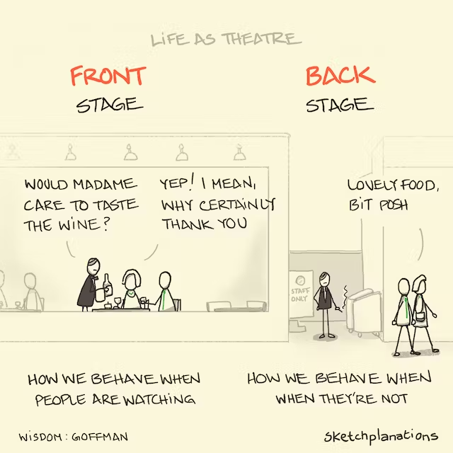
For example:
A waiter or waitress at a restaurant. Their main avenue of concern is "customer service." Even if a customer is rude, they are expected to be polite ("the customer is always right") as part of their job responsibilities.
That same waiter or waitress speaks differently when going out to her/his break room. S/he may complain, mimic and discuss with their fellow peers how irritating and rude the customer is.
In this example, the waiter/waitress acts a certain way when dealing with customers and acts a completely different way when with her/his fellow employees.

Slide 36

Video
Notes:
https://www.youtube.com/watch?v=5Qe5TI__ZDU

Slide 37
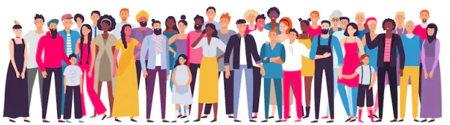
What is society then?
In sociological terms, society refers to a group of people who live in a definable community and share the same cultural components.
Sociologist Gerhard Lenski Jr. (1924–2015) defined societies in terms of their technological sophistication. As a society advances, so does its use of technology.
Societies with simple technology depend on the fluctuations of their environments, while industrialized societies have more control over the impact of their surroundings and thus develop different cultural features.
Sociologists generally classify societies along a spectrum of their level of industrialization—from preindustrial to industrial to postindustrial.

Slide 38
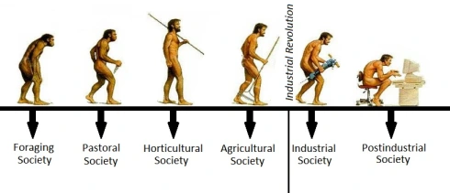
Types of societies
Preindustrial Societies
Industrial Society
Postindustrial Society

Slide 39
Hunting and Gathering
A society that survived by hunting animals and gathering edible plants.
Horticultural
Pastoral
Agricultural
Industrial
Post industrial
A society in which economic emphasis is on providing services and information.
A society that depends on science and technology to produce its goods and services.
A society that uses plows and draft animals in growing food.
A society in which food is obtained primarily by raising and taking care of animals.
A society that survives primarily through the growing of plants.

